Slide 1
Intelligent Classification of Rural Infrastructure Projects USING MACHINE LEARNING
CAPSTONE PROJECT
Presented By:
1. RAJ GUPTA-AMITY UNIVERSITY CHHATTISGARH-CSE

Slide 2
OUTLINE
Problem Statement
Proposed System/Solution
System Development Approach (Technology Used)
Algorithm & Deployment
Result (Output Image)
Conclusion
Future Scope
References

Slide 3
Problem Statement
Content: The Pradhan Mantri Gram Sadak Yojana (PMGSY) is a flagship rural development program in India, aimed at providing all-weather road connectivity to unconnected habitations.
Over time, the program evolved through multiple phases:
PMGSY-I
PMGSY-II
RCPLWEA, etc.
Challenges faced:
Thousands of projects with varying objectives, funding, and specifications.
Manual classification is time-consuming and error-prone.
Need for automated classification for efficient monitoring, transparent budgeting, and policy analysis.
Task: Design and implement a machine learning model to classify each rural infrastructure project into the correct PMGSY scheme based on physical and financial characteristics.

Slide 4
Proposed Solution
The proposed system aims to address the challenge of automatically classifying rural infrastructure projects into their correct PMGSY scheme. This ensures efficient monitoring, transparent budgeting, and policy analysis. The solution leverages IBM Cloud Watsonx AI to build, deploy, and scale a reliable classification model.
The solution will consist of the following components:
1. Data Collection
Collect project-level data including
Project Type (Road / Bridge)
Length, Cost, and Funding Pattern
Location & District information
Project Start & Completion Dates
Store raw datasets in IBM Cloud Object Storage (COS) for secure and scalable storage.
4. Deployment (Watsonx Ecosystem)
Deploy the trained model to Watsonx Deployment Space for real-time predictions.
Use Watsonx Runtime API with IBM API Key to integrate predictions into external applications.
Any authorized user can enter project details and receive the predicted scheme instantly.
2. Data Preprocessing
Clean the dataset by handling missing values, duplicates, and outliers.
Convert categorical features (like project type, district) into numerical encodings.
Normalize financial and physical parameters for better model accuracy.
5. Evaluation & Monitoring
Evaluate the deployed model using test datasets and live predictions.
Maintain continuous monitoring and performance tracking using Watsonx logs.
Update the model periodically as new project data is added to improve accuracy.
3. Machine Learning Model (Watsonx AI Studio)
Train a classification model (Random Forest / XGBoost) in Watsonx AI Studio.
Input Features: Cost, Length, Funding Type, Project Type, and District.
Output: Predicted Scheme – PMGSY-I / PMGSY-II / RCPLWEA.
Evaluate model using Accuracy, Precision, Recall, and F1-Score.

Slide 5
System Approach
The "System Approach" section outlines the overall strategy and methodology for developing and implementing the rental bike prediction system. Here's a suggested structure for this section:
The Intelligent Classification of Rural Infrastructure Projects is developed using a cloud-based ML workflow on IBM Watsonx AI Studio, following these stages:
1️⃣ Data Collection & Storage
Source: PMGSY dataset (2,189 records)
Features: Road/Bridge count & length, Cost, Expenditure, State, District
Storage: IBM Cloud Object Storage (COS)
4️⃣ Deployment & Integration
Deployed on: Watsonx Deployment Space
Prediction: via Watsonx Runtime API (IBM API Key)
Flow: User Input → API → Prediction
2️⃣ Data Preprocessing
Removed empty column (Unnamed:14)
Filled missing financial values
Normalized lengths & costs
Encoded State & District for ML model
5️⃣ Monitoring & Evaluation
Metrics: Accuracy, Precision, Recall, F1-score
Monitoring: Deployment logs & periodic model updates
3️⃣ Model Training (Watsonx AI Studio)
Algorithm: Random Forest / XGBoost
Input: Road, Bridge, Cost, Expenditure, Location
Output: PMGSY_SCHEME (I / II / RCPLWEA / etc..)
Split: 90/10 → High accuracy achieved

Slide 6
Algorithm & Deployment
Algorithm:
XGBoost Classifier on Watsonx AI Studio
Handles both numerical & categorical project features
Deployment Workflow:
Upload dataset to IBM Cloud Object Storage
Train model in Watsonx AI Studio
Deploy model in Watsonx Deployment Space
Access predictions via Watsonx Runtime API using IBM API Key

Slide 7
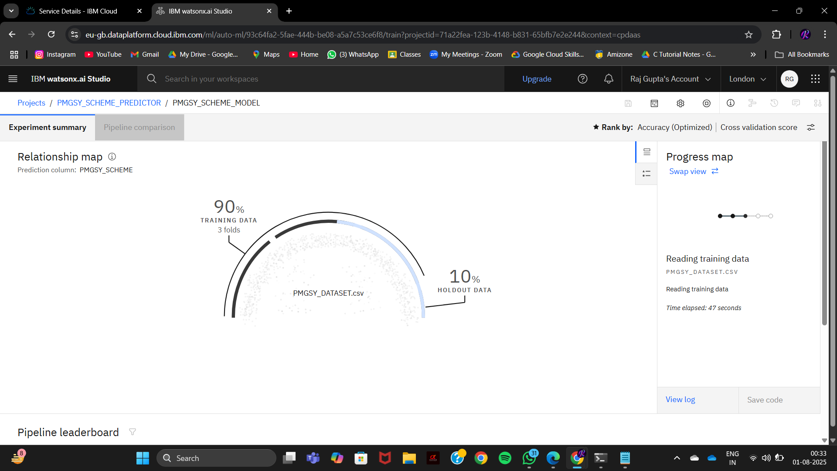
Result

Slide 8
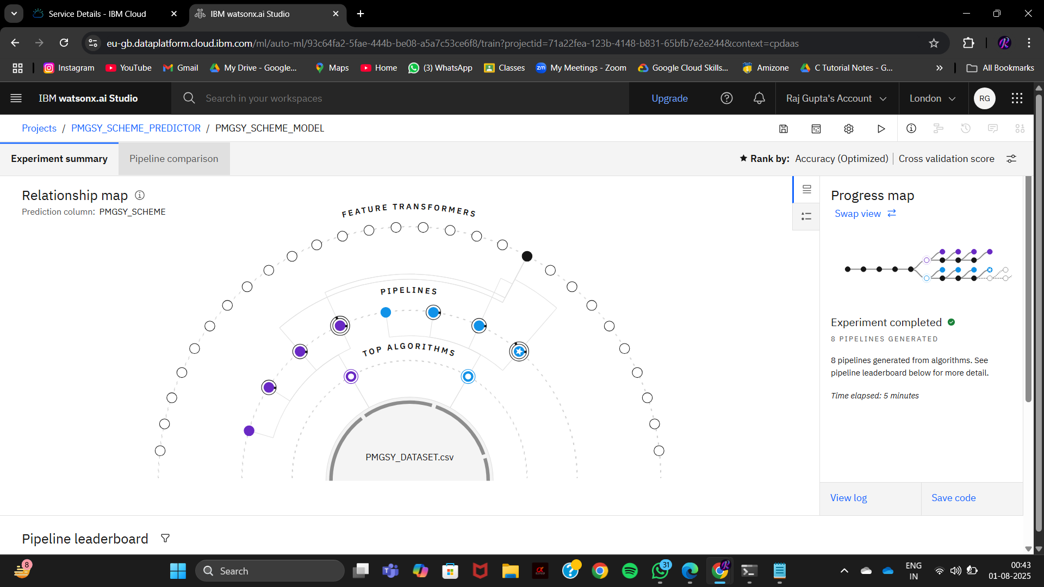
Result

Slide 9
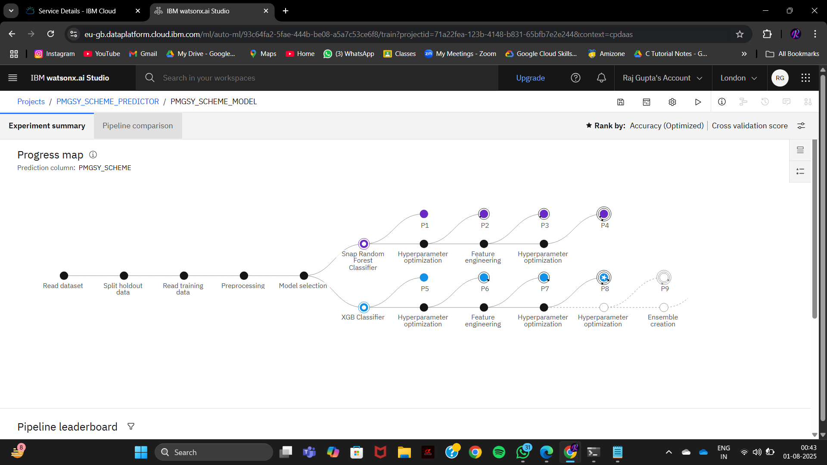
Result

Slide 10
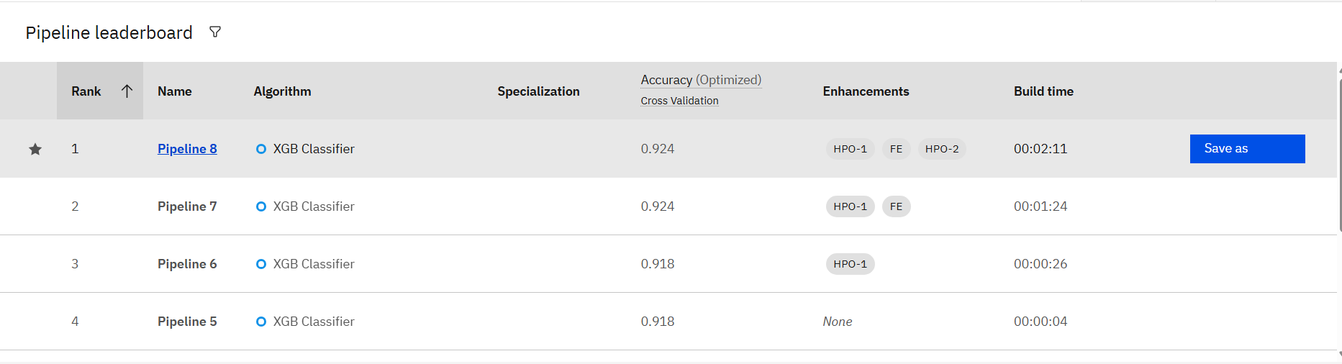
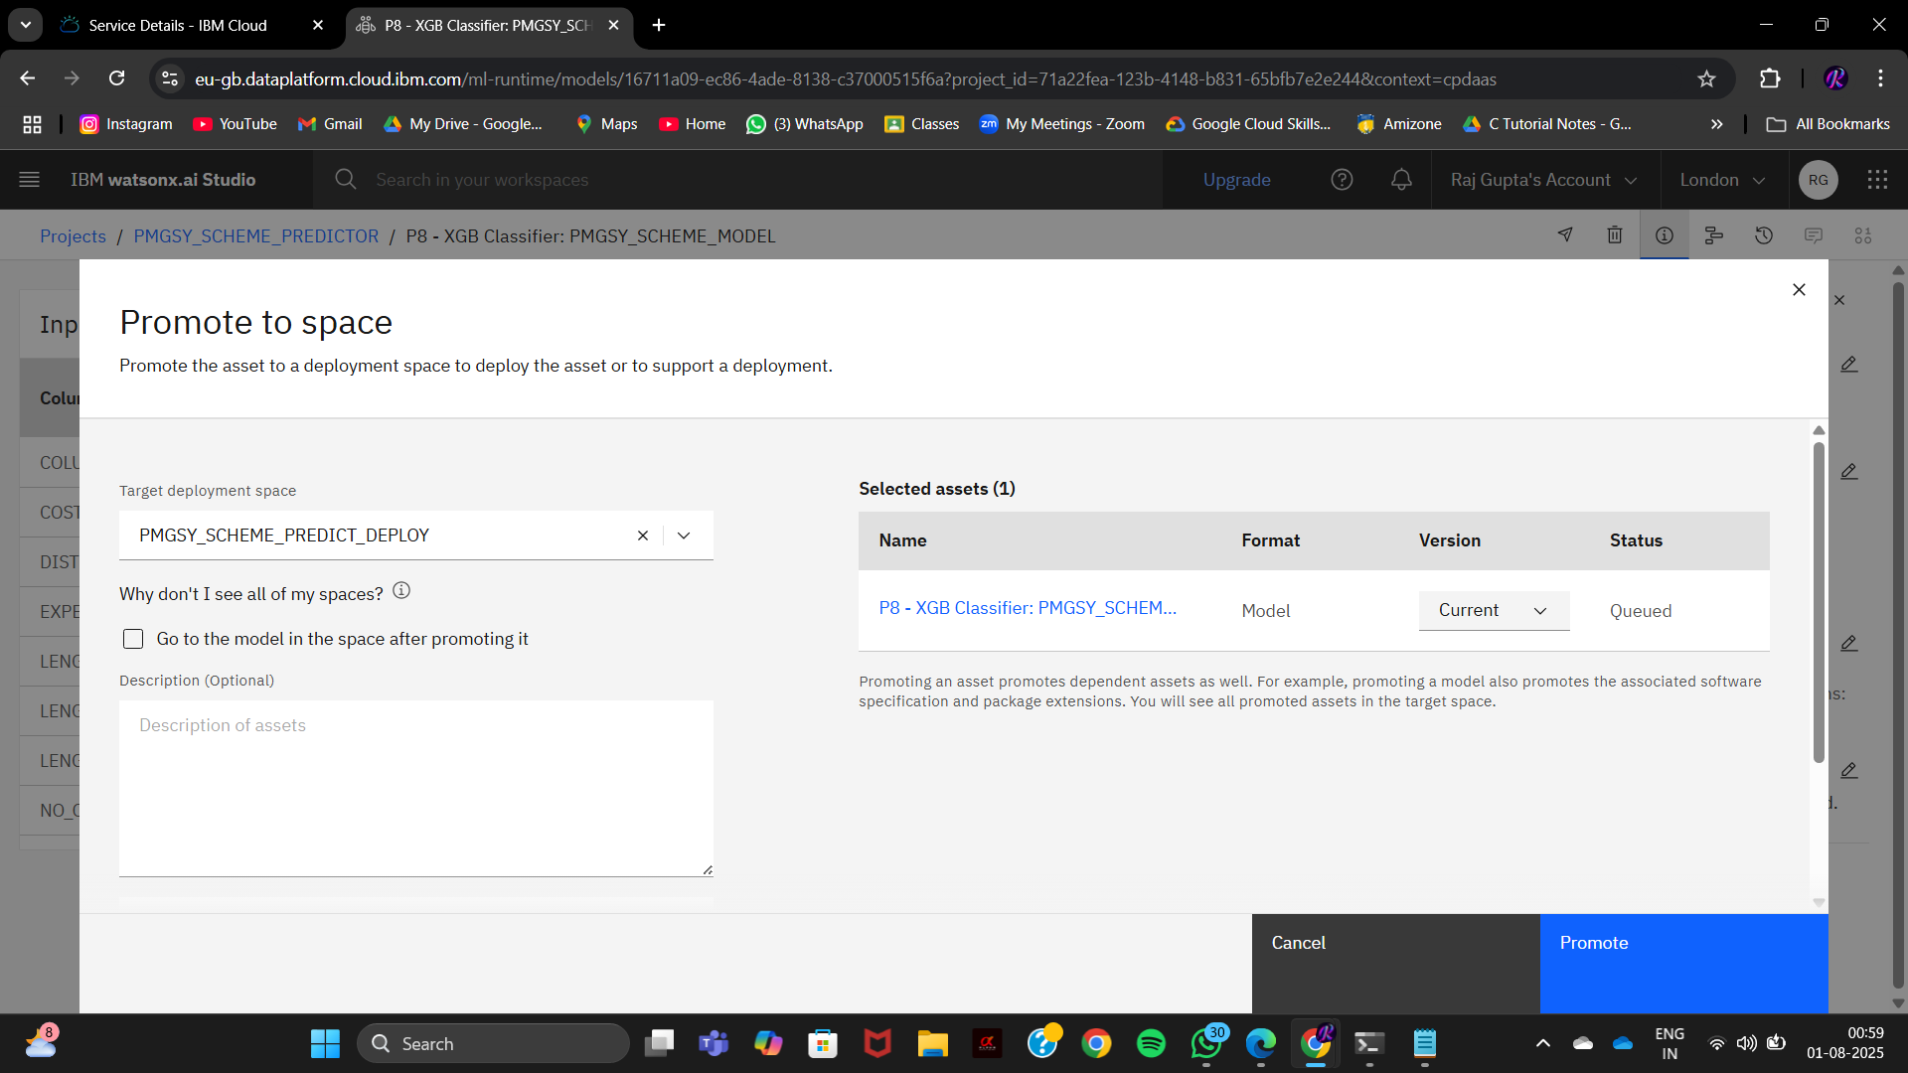
Result

Slide 11
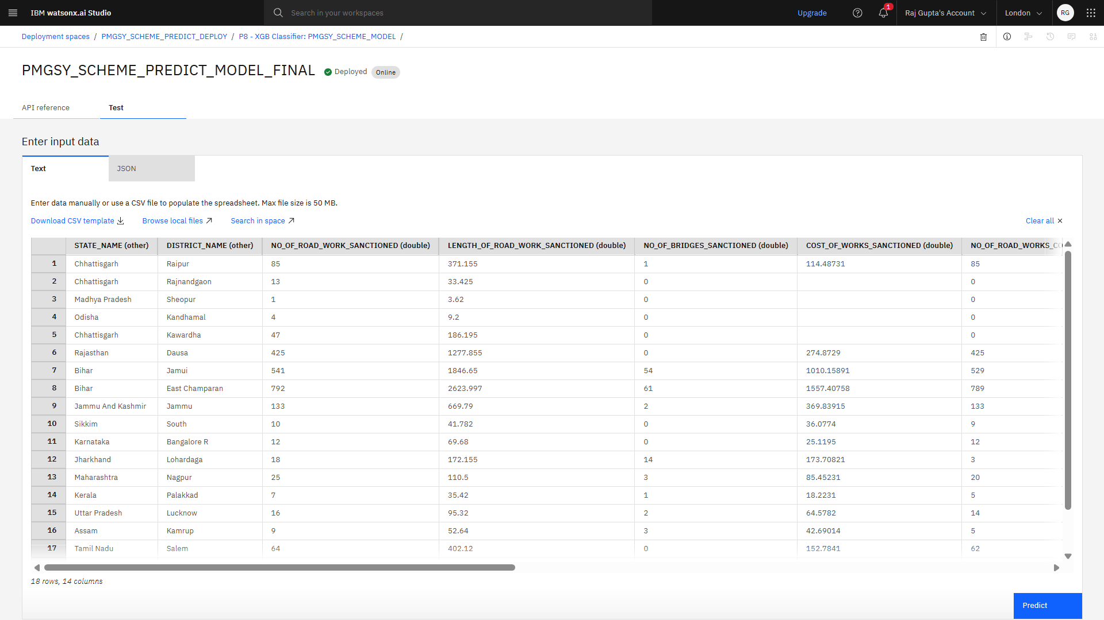
Result

Slide 12
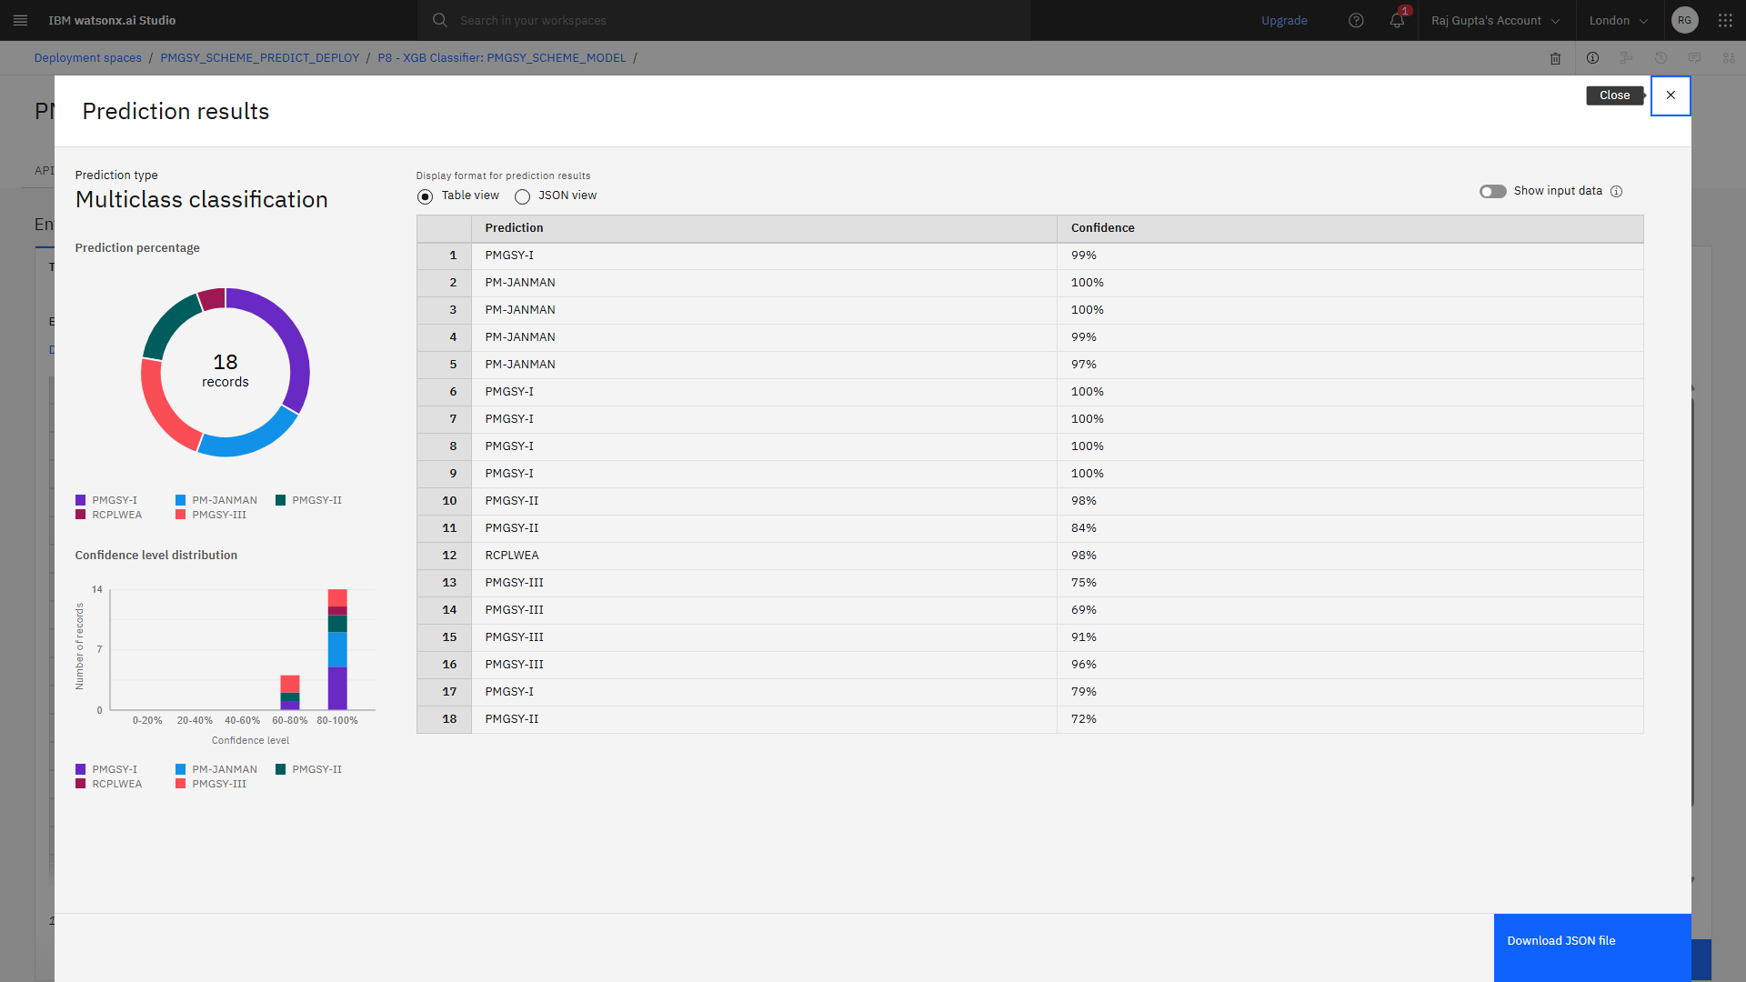
Result

Slide 13
Conclusion
Successfully developed a cloud-based ML system for classifying rural infrastructure projects into PMGSY schemes.
Leveraged IBM Watsonx AI Studio for model building, training, and deployment.
Automated project classification reduces manual effort and human errors, enabling efficient monitoring and transparent budgeting.
The Watsonx Runtime API allows real-time integration with external applications for on-demand predictions.

Slide 14
Future scope
Integration with Government Databases
Connect with live PMGSY & rural infrastructure portals for real-time classification.
Interactive Dashboard
Build a Streamlit / Flask dashboard hosted on IBM Cloud for visual analytics and instant scheme prediction.
Multi-Scheme Expansion
Extend classification to other rural development schemes (e.g., PMAY, MGNREGA).
Advanced AI Enhancements
Use Watsonx Data for large-scale data handling and AutoAI for continuous model improvement.
Geo-Analytics Integration
Add GIS-based insights for mapping project locations and monitoring their progress visually.

Slide 15
References
IBM Watsonx AI Documentation – https://www.ibm.com/watsonx
PMGSY Official Portal – https://pmgsy.nic.in
IBM Cloud Object Storage Docs – https://cloud.ibm.com/docs/cloud-object-storage
Research Paper: “Infrastructure automated defect detection with machine learning: a systematic review” https://www.tandfonline.com/doi/full/10.1080/15623599.2025.2491622
Dataset Source – PMGSY Project Dataset (2,189 Records) / https://aikosh.indiaai.gov.in/web/datasets/details/pradhan_mantri_gram_sadak_yojna_pmgsy.html

Slide 16
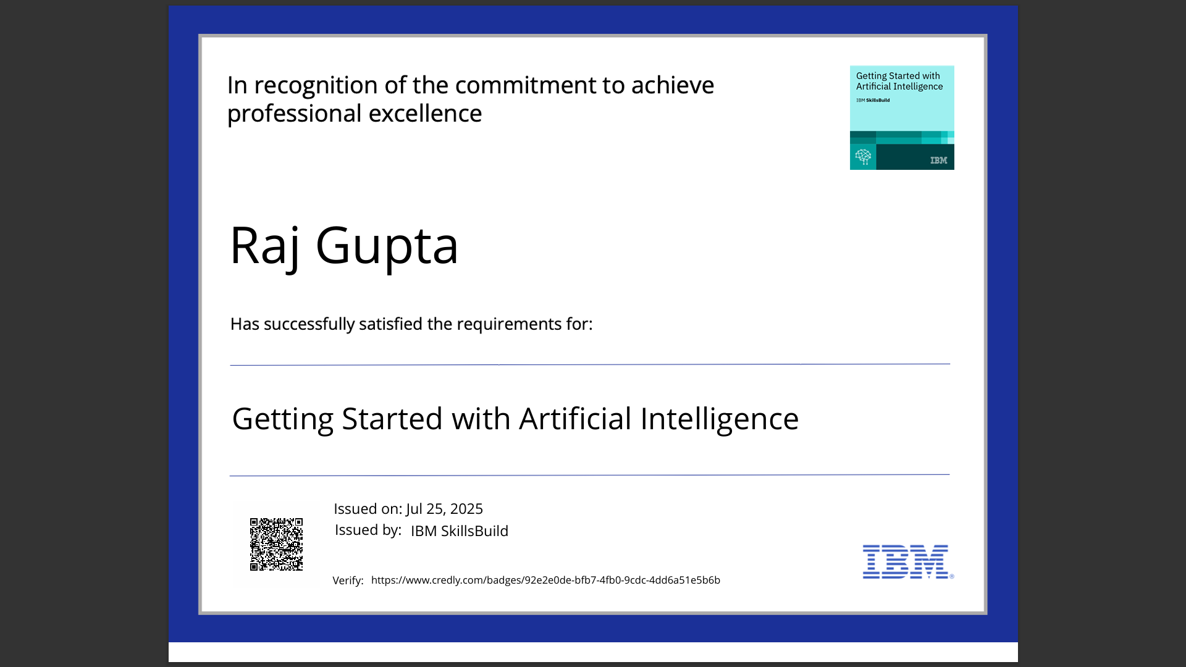
IBM Certifications

Slide 17
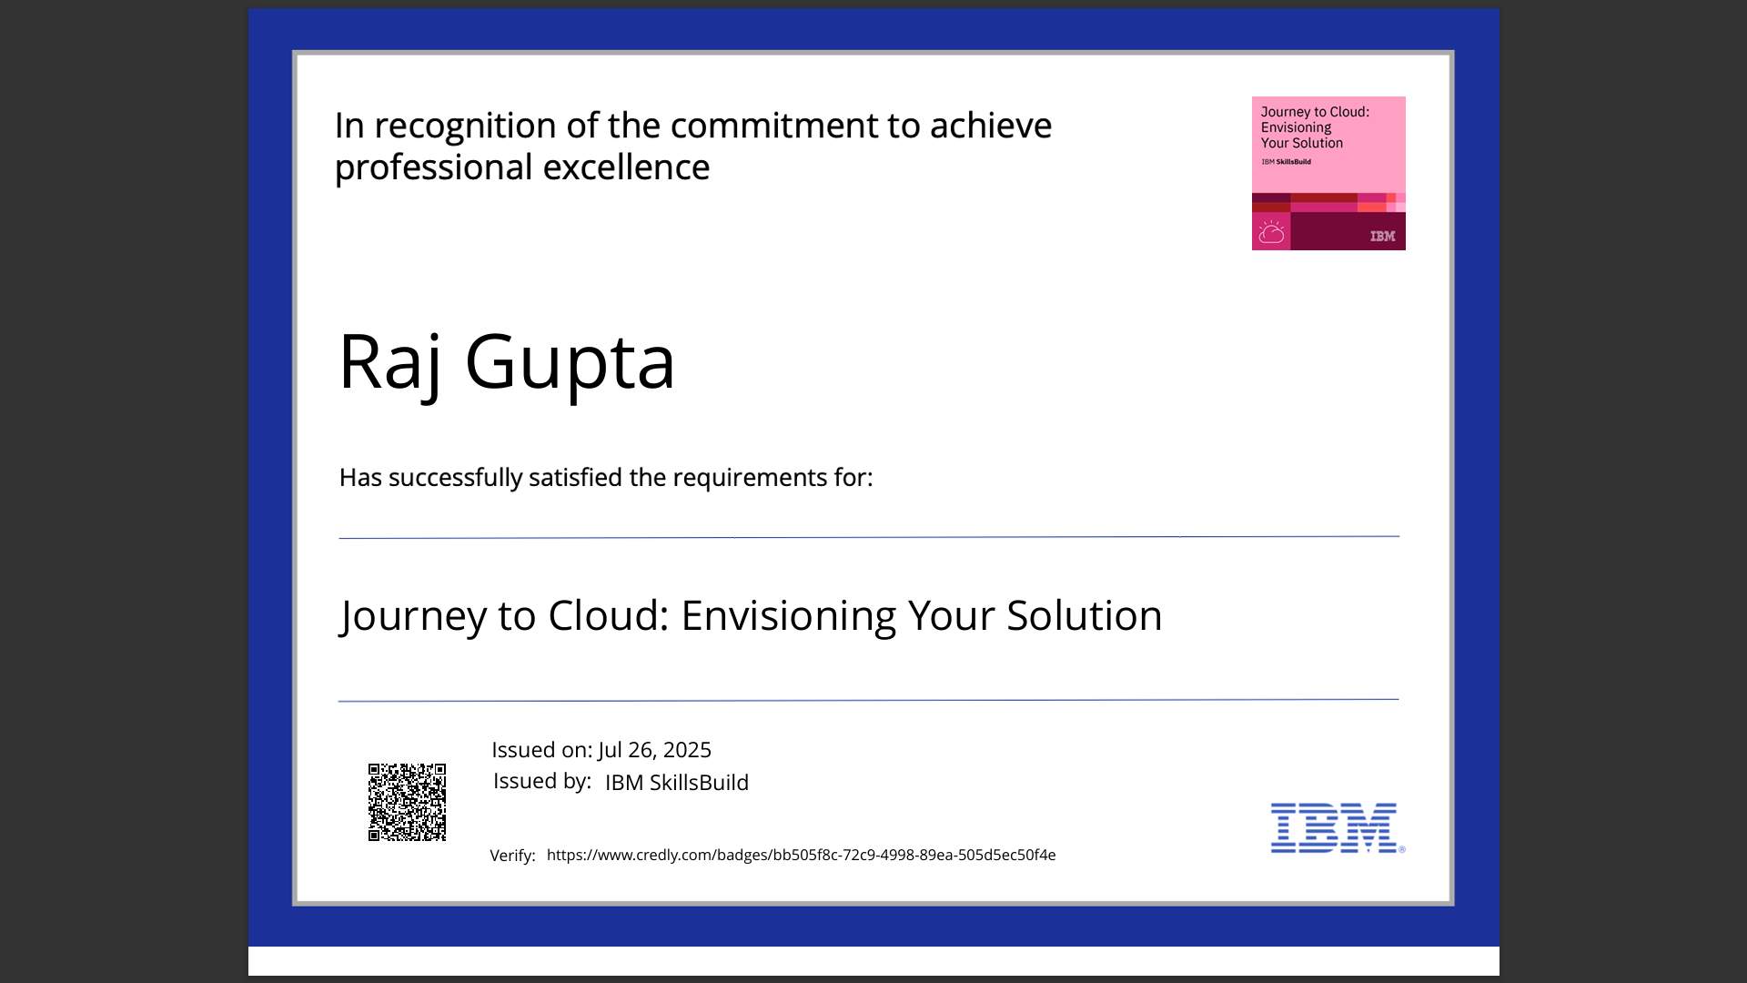
IBM Certifications

Slide 18
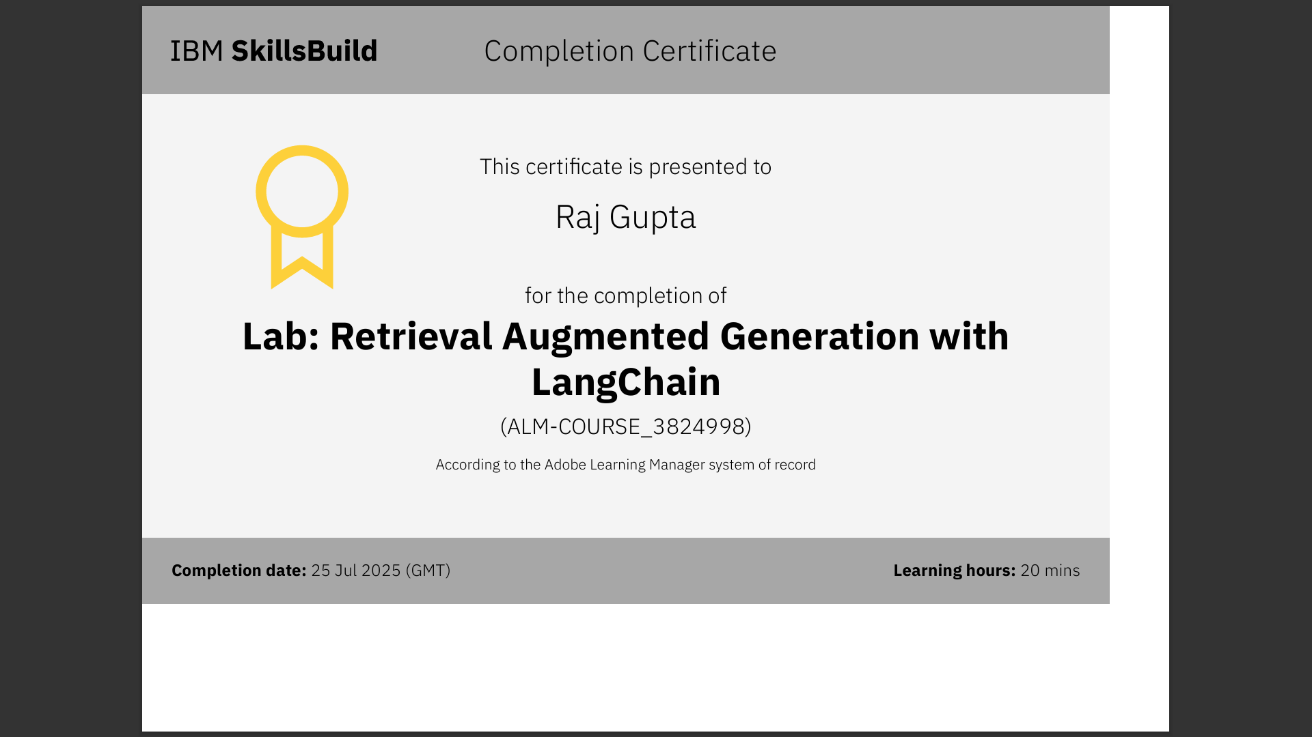
IBM Certifications

Slide 19
THANK YOU

